Slide 1
Meeting Notes
November 6, 2025

Slide 2
MUT development
Triangular mesh generation
  Generate a triangular mesh inside a polygon
  Refine the mesh within a polygon
  Add wells with some refinement

Slide 3
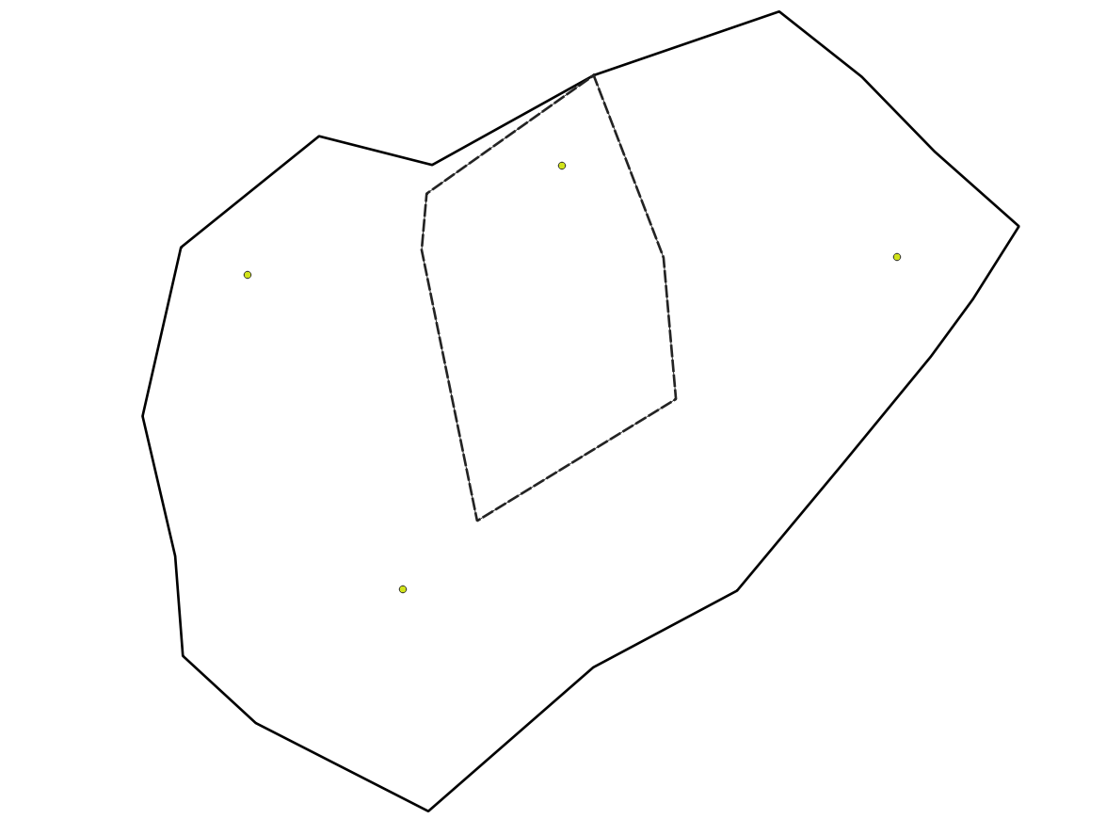
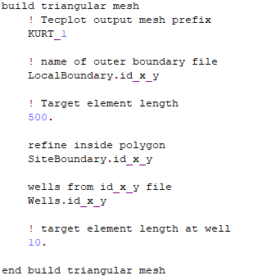
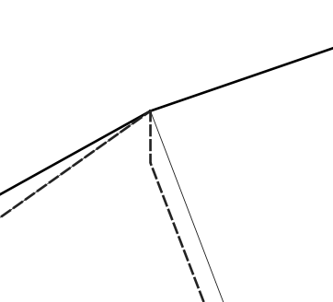
Removed 1 short segment in Site boundary

Slide 4
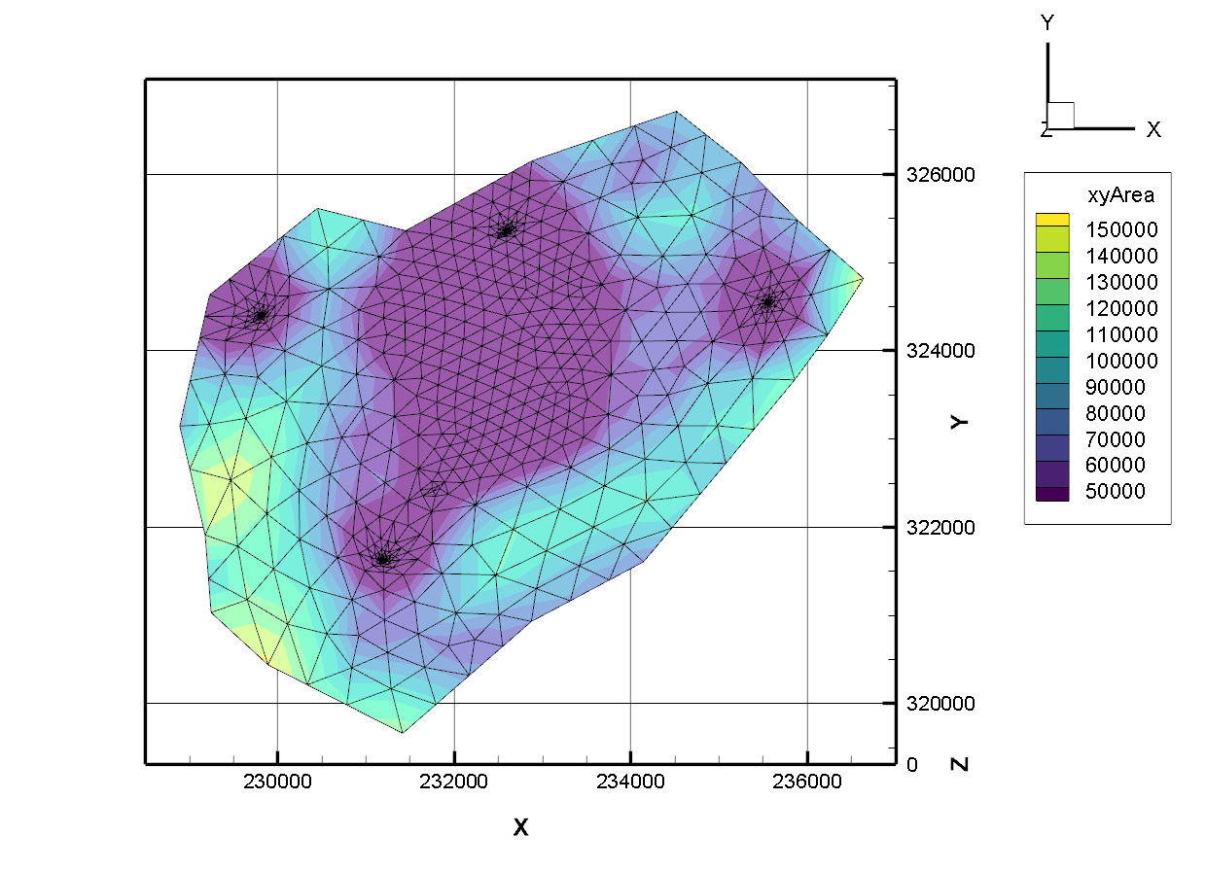

Slide 5
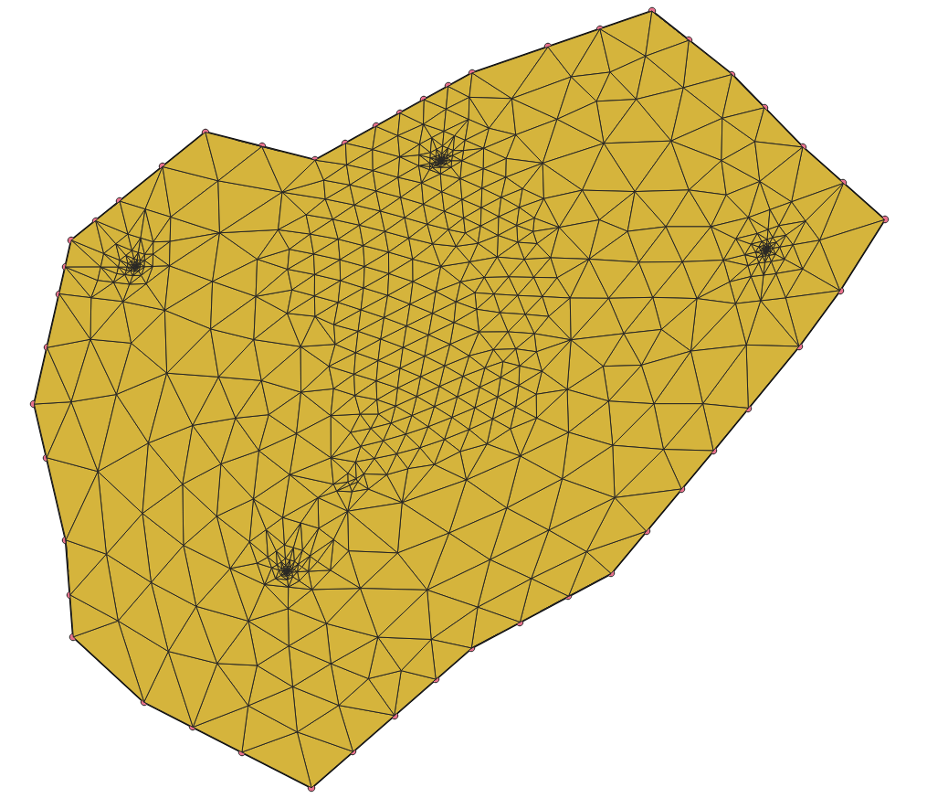
Delaunay triangulation can be done inside QGIS

Slide 6
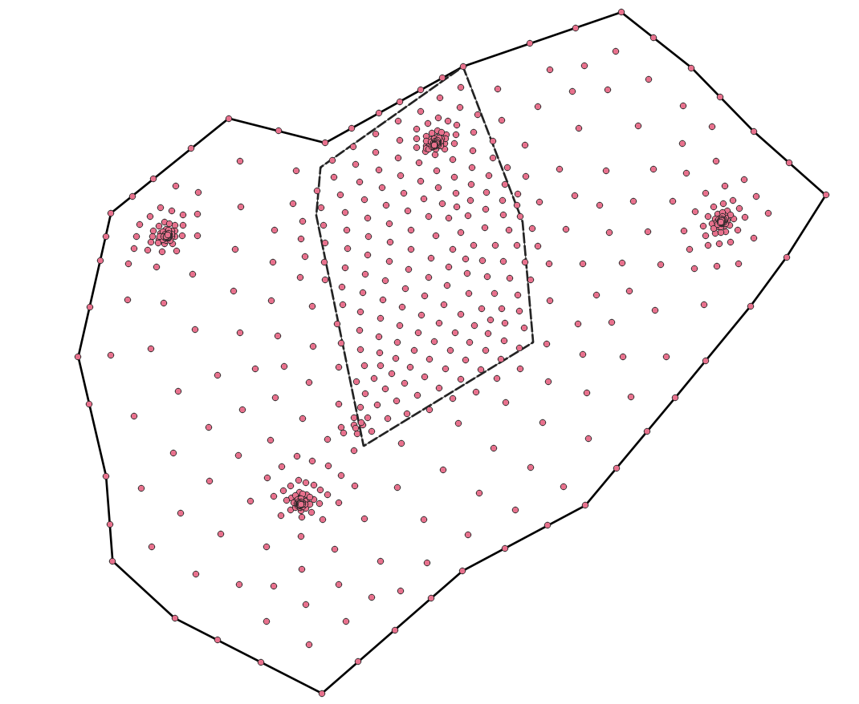
Node coordinates can be exported from Tecplot and imported to QGIS

Slide 7
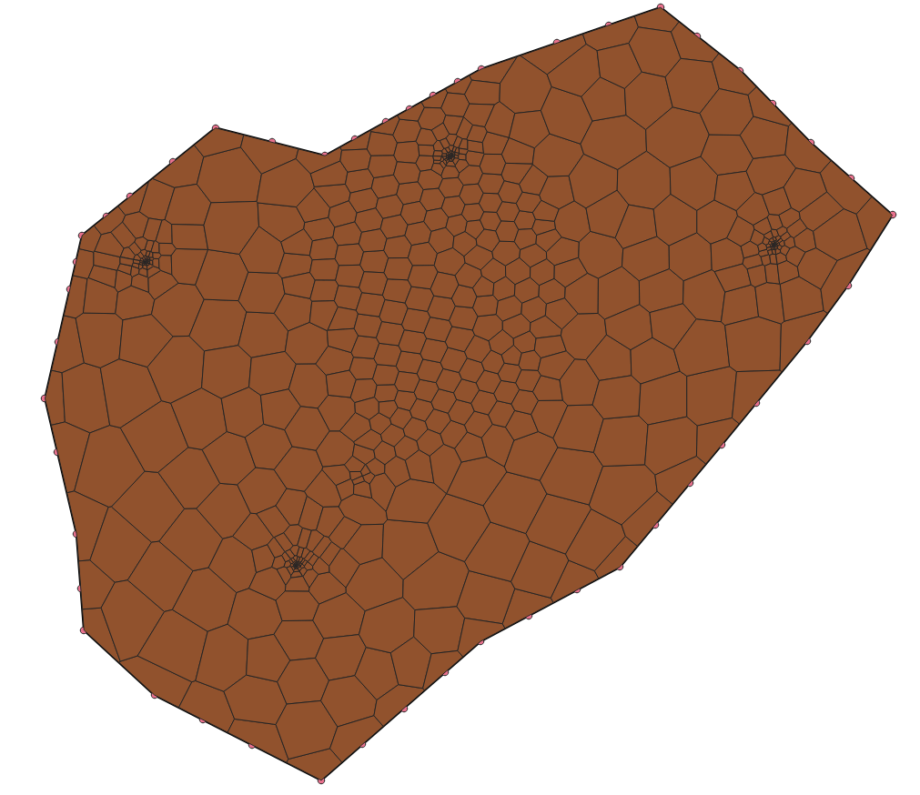
Also Voronoi polygons

Slide 8
Modularization
  A work in progress
  For now the focus is just to get the client model working which requires a bit of cleanup

Slide 9
MUT User’s Guide Update
  Once development is frozen I need to go through the entire manual

Slide 10
KURT Report
This is a LaTeX document being written on the fly as I develop the client model
  There is a lot of how-to QGIS information specific to client data

Slide 11
USGS_1 Development
output cell Vx, Vy, Vz components
Fracture flow

Slide 12
